Slide 1
CORE JAVA PROJECT
ATM INTERFACE
By
Punam Dhande

Slide 2
Introduction :-
Automated Teller Machine enables clients of a bank to have access to their account without going to the bank. This is achieved only by development the application using online concepts.
In the ATM interface project, the user has to select an option from the options displayed on the screen. The options are related to withdraw the money, deposit the money, check the balance, and exit.
To withdraw the money, we simply get the withdrawal amount from the user and remove that amount from the total balance and print the successful message.
To deposit the money, we simply get the deposit amount from the user, add it to the total balance and print the successful message.
To check balance, we simply print the total balance of the user.

Slide 3
AIM :-
To achieve transactions in the account more securely and easily.
To save the mini-statements of each transaction.
To achieve Fastest way to deposit withdraw money.

Slide 4
Hardware Requirements :-
Software Requirement :-
Processor | Intel Core i3
Memory | 32 MB Ram
Operating System | Window
Front End | Java
Back End | MySQL

Slide 5
Modules :-
In this ATM INTERFACE Project there has 6 main operations.
Verification Process → verifying user by using username and pin
View Balance →User can view account balance.
Deposit →User can add money to existing account
Withdraw →User can withdraw money from your account
View Mini Statements →User can view all transaction history.

Slide 6
INITIAL SETUP :-
Software Editor :- Eclipse
Software Database : MySQL
Maven Project Name :- ATM Interface
Package Name :- com.project
Classes Name :- > MainClass
>Get_Record_Atm

Slide 7
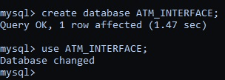
(IN DATABASE) : creating and using database-

Slide 8
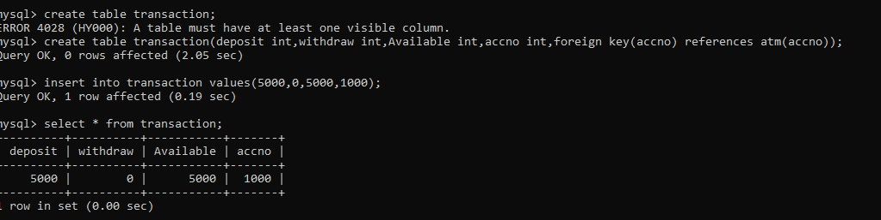
Creating new table for storing transactions:

Slide 9
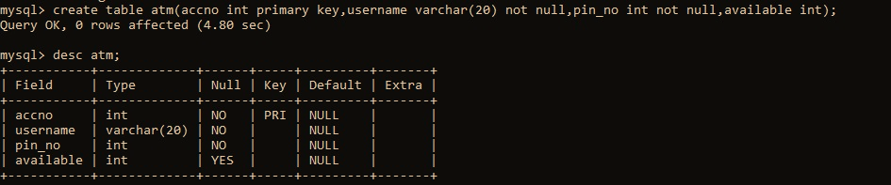
Creating describing table structure :

Slide 10
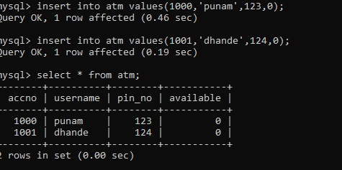
Inserting and Displaying records:

Slide 11
THANK YOU

